Slide 1

EliteDecor
Your Premier Online Furniture and Home Decor Store
Welcome to EliteDecor, your one-stop shop for stylish and affordable home furnishings.

Slide 2

EliteDecor
EliteDecor is an online platform where customers can discover and purchase high-quality home decor items tailored to their unique style and preferences. Our website provides a vast selection of decor products, from elegant furniture and lighting to exquisite artwork and accessories, designed to transform any space into a beautiful, comfortable, and personalized home. Whether customers are redecorating a single room or designing an entire home, EliteDecor offers the perfect blend of quality, style, and customisation, allowing everyone to create their dream space with ease.

Slide 3



Browsing and Shopping Experience
User-Friendly Website
Detailed Product Information
Seamless Navigation
Our website features a sleek and intuitive interface, making it easy for you to browse and find the perfect home furnishings.
Each item in our catalog is presented with stunning photography and comprehensive descriptions to help you make informed purchasing decisions.
Navigating our extensive product categories is a breeze, allowing you to easily find the perfect pieces to complement your home.

Slide 4




Your Shopping Cart
Add to Cart
Simply click "Add to Cart" for any item.
Manage Items
Update quantities, remove items, and review your order.
Proceed to Checkout
Enter your shipping and payment information.

Slide 5
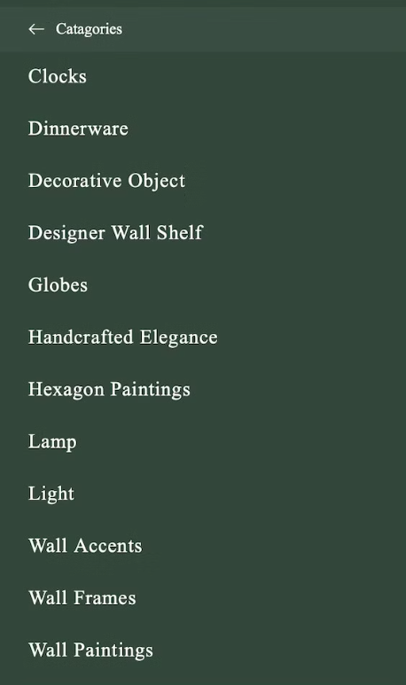
Our Product Categories
Explore Our Extensive Collection
From stylish living room furnishings to cozy bedroom essentials, our product categories cater to every room in your home. Discover our wide array of high-quality furniture and decor to transform your space.

Slide 6



Pricing and Discounts
Competitive Pricing
Regular Promotions
Discount Codes
Our furniture and home decor items are priced competitively, providing exceptional value to our customers.
We offer regular seasonal sales, flash deals, and special offers to help you save on your purchases.
Stay up to date with our exclusive discount codes and vouchers to maximize your savings.

Slide 7

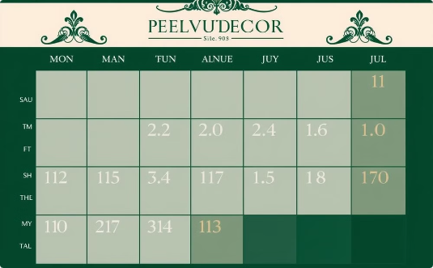

Delivery and Shipping
Reliable Shipping Options
Estimated Delivery Times
Track Your Order
We partner with top delivery providers like ECOM Express, Delivery, DHL, Blue Dart to ensure your orders arrive quickly and safely.
Enjoy fast, reliable delivery with estimated arrival dates displayed for each item in your cart.
Stay informed every step of the way with real-time order tracking. Monitor your delivery status directly through our website.

Slide 8



Payment Options
Credit Cards
PayPal
Cash on Delivery (COD)
We accept all major credit cards, including Visa, Mastercard, American Express, and Discover, for a secure and convenient payment experience.
Easily and securely pay with your PayPal account, a trusted online payment solution that offers additional protection for your transactions.
For your convenience, we also offer the option to pay in cash upon delivery of your order, ensuring a flexible payment experience.

Slide 9

Customer Support and Service
Email Support
For inquiries and follow-ups.
Return and Exchange
Hassle-free returns within a specified timeframe.
FAQs
For common customer queries.

Slide 10
Contact Information
Website
Social Media
Visit us at theelitdecor.com for our full product catalog and shopping experience.
Follow us on Instagram, Facebook, and Twitter to stay updated on the latest trends and promotions.
1
2
3
Customer Service
Reach out to our friendly support team via email or phone for any inquiries or assistance.

Slide 11
Thank You

